Slide 1
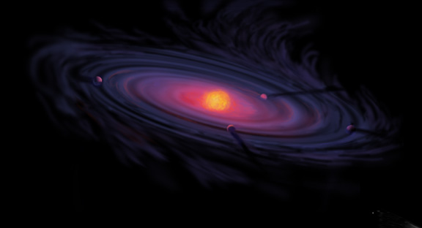
Origins of Gas Giant Compositions: The Role of Disk Location and Dynamics
Ana-Maria Piso
Thesis Colloquium: April 27th, 2016

Slide 2
Fundamental Questions
Where in the disk can giant planets form?
What compositions will the formed giant planets have obtained?

Slide 3
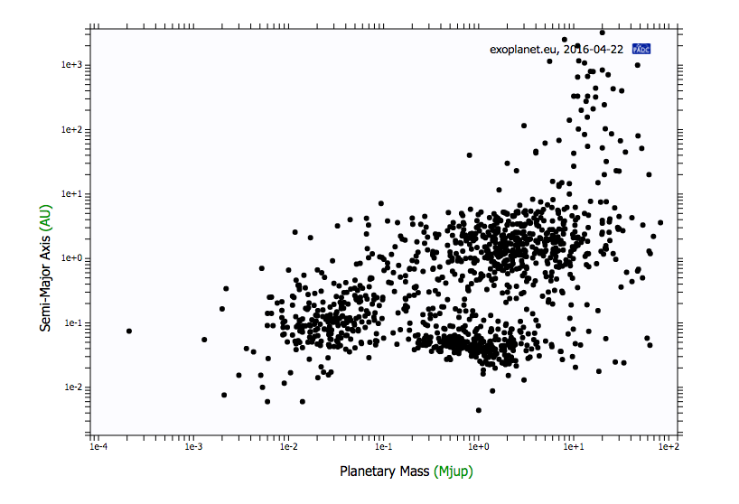
exoplanet.eu

Slide 4
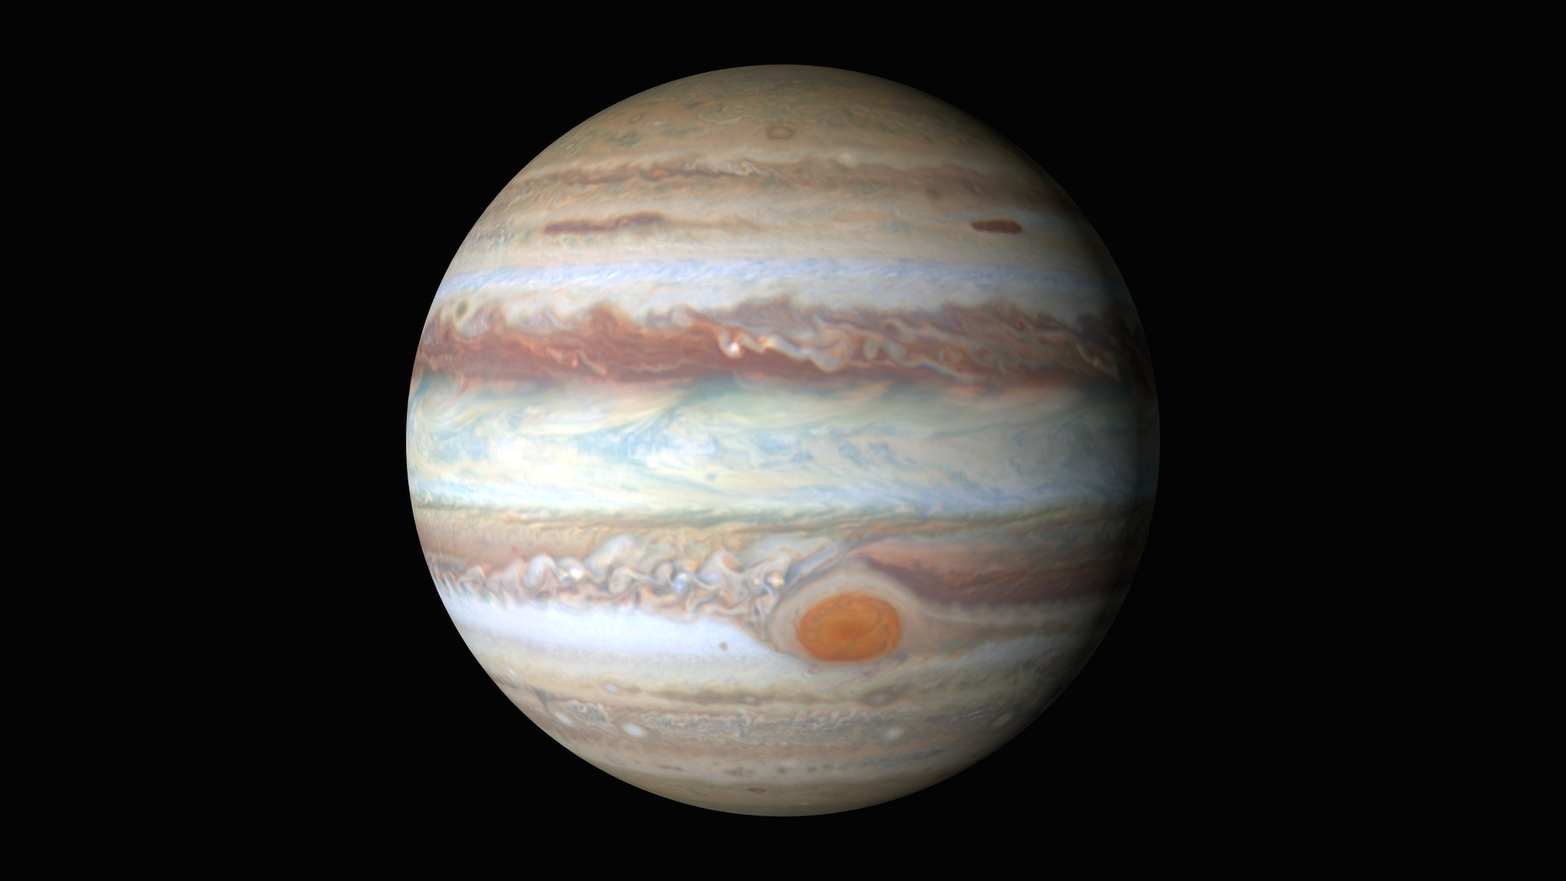
Gas Giants
Notes:
Picture of e.g. Jupiter and discuss why gas giants are important, and why we preferentially look at giant planets atmospheric spectra; there are also more problematic to form

Slide 5

Disk-Planet Connection
The composition of planets is determined by and tightly linked to the disk composition

Slide 6
Thesis Structure
The role of disk location in the formation of wide separation gas giants (Piso et al. 2014, 2015a)
The effect of disk structure and composition at different radii on the eventual composition of giant planets (Piso et al. 2015b, Piso et al. 2016)

Slide 7
Thesis Structure
The role of disk location in the formation of wide separation gas giants (Piso et al. 2014, 2015a)
The effect of disk structure and composition at different radii on the eventual composition of giant planets (Piso et al. 2015b, Piso et al. 2016)

Slide 8
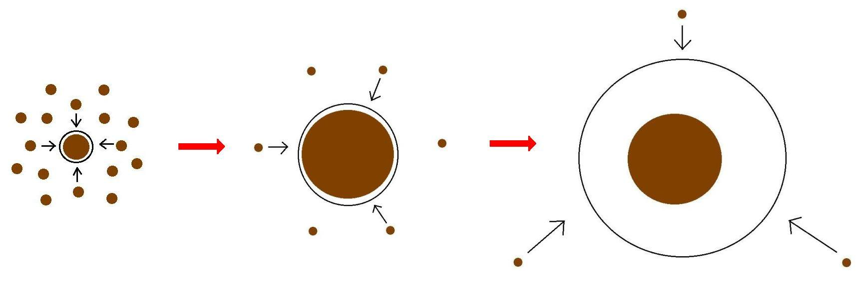
Minimum Core Masses for Giant Planet Formation

Slide 9
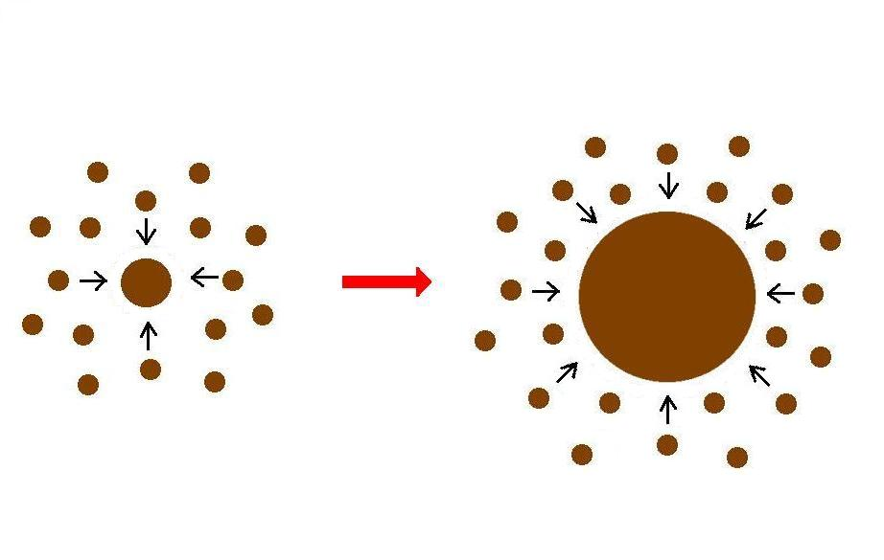
Giant planet formation requires fast core growth

Slide 10
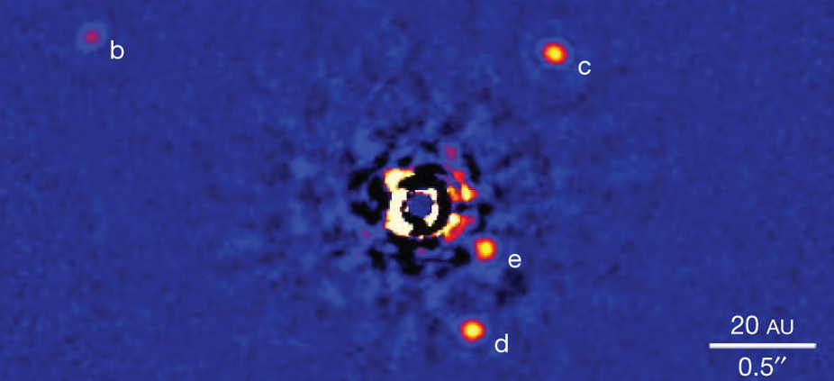
Marois+2010

Slide 11
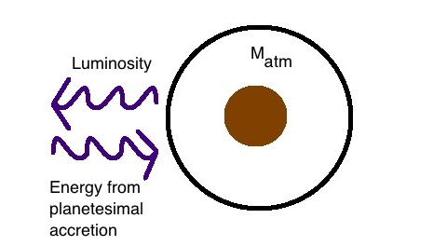
Core Accretion at high planetesimal accretion rates yields steady state
=> M_{atm} is a function of M_{core}
M_{core}

Slide 12

High planetesimal accretion
ONE M_{atm} for each M_{core}
=> ONE core mass for which M_{atm} ~ M_{core} = “critical core mass”
M_{atm,2}
M_{atm,1}
M_{core,1}
M_{core,2}

Slide 13
Planetesimal accretion is not constant at a given location throughout disk life
e.g., Pollack+96, Ikoma+00
M_{atm} << M_{core}
HIGH dM_{core}/dt
M_{atm} << M_{core}
dM_{core}/dt goes down
M_{atm} ≤ M_{core}
LOW dM_{core}/dt

Slide 14
Planetesimal accretion is not constant at a given location throughout disk life
e.g., Pollack+96, Ikoma+00
M_{atm} << M_{core}
HIGH dM_{core}/dt
M_{atm} << M_{core}
dM_{core}/dt goes down
M_{atm} ≤ M_{core}
LOW dM_{core}/dt

Slide 15
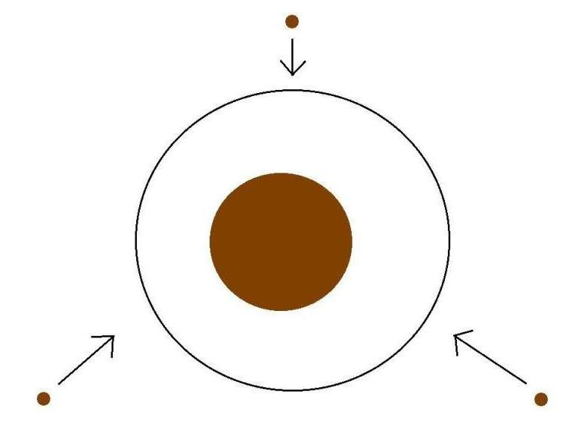
Low planetesimal accretion regime
Atmospheric evolution dominated by
Kelvin-Helmholtz contraction
M_{atm}
M_{core}
M_{atm} ≤ M_{core}
LOW dM_{core}/dt

Slide 16
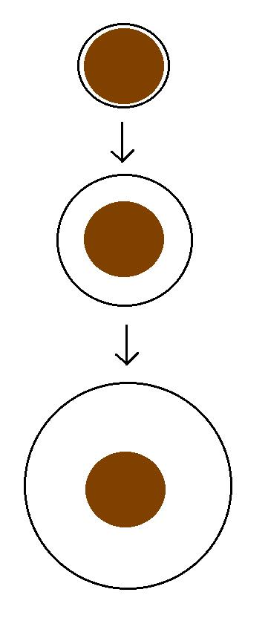
Kelvin-Helmholtz contraction
M_{atm} is a function of time
=> EVERY core can have
M_{atm} ~ M_{core}
“critical core mass”
M_{crit} = M_{core} for which
M_{atm}(t_{disk}) ~ M_{core}
M_{atm}(t₁)
M_{core}
M_{atm}(t₂)
M_{core}
M_{atm}(t₃) ~ M_{core}
M_{core}

Slide 17
GOAL
Determine the minimum core mass, M_{crit}, to form a giant planet during the disk lifetime in the low planetesimal accretion regime when atmosphere dominated by KH contraction
Calculate M_{crit} with
REALISTIC EQUATION OF STATE (EOS)
REALISTIC DUST OPACITIES

Slide 18
Model Assumptions
Negligible planetesimal accretion => solid core of fixed mass M_{c}
Atmosphere is embedded in the gas disk, spherically symmetric and in hydrostatic balance
Two layer atmosphere: inner convective region and outer radiative region
Constant luminosity throughout the radiative region
see Piso & Youdin (2014) for details

Slide 19
Static profiles connected by global cooling equation
CONVECTIVE
RADIATIVE
L ~ -dE/dt
a = 10 AU, M_{c} = 5 M_{E}
Adiabatic gradient relates P, T, rho => determines atmospheric profile and parametrizes EOS
a = 10 AU, M_{c} = 5 M_{E}

Slide 20
Atmospheric evolution and M_{crit} are highly dependent on
EQUATION OF STATE
DUST OPACITY

Slide 21
Atmospheric evolution and M_{crit} are highly dependent on
EQUATION OF STATE
DUST OPACITY

Slide 22
Adiabatic gradient is variable for realistic EOS
Piso, Youdin, & Murray-Clay (2015)

Slide 23
Adiabatic gradient is variable for realistic EOS
Saumon+95
Piso, Youdin, & Murray-Clay (2015)
Our extension

Slide 24
Adiabatic gradient is variable for realistic EOS
Piso, Youdin, & Murray-Clay (2015)
H2 dissociation
H ionization
Ideal gas

Slide 25
Adiabatic gradient is variable for realistic EOS
Piso, Youdin, & Murray-Clay (2015)
Partially excited H₂ rotational states

Slide 26
Adiabatic gradient is variable for realistic EOS
H₂ spin isomers ORTHOHYDROGEN and PARAHYDROGEN can be in thermal equilibrium or fixed ratio
Piso, Youdin, & Murray-Clay (2015)
Ortho-para equilibrium
Fixed 3:1 ortho-to-para ratio
Partially excited H₂ rotational states

Slide 27
Variations in due to non-ideal EOS effects INCREASE M_{crit}
ad
t_disk ~ 3 Myr, ISM opacity
Piso, Youdin, & Murray-Clay (2015)

Slide 28
Atmospheric evolution and M_{crit} are highly dependent on
EQUATION OF STATE
DUST OPACITY

Slide 29
Atmospheric evolution and M_{crit} are highly dependent on
EQUATION OF STATE
DUST OPACITY

Slide 30
Grain growth opacity DECREASES M_{crit}
dN/ds ~ s^{-p}
p = 3.5
s_{max} = 1 cm
t_disk ~ 3 Myr, realistic EOS
t_disk ~ 3 Myr, realistic EOS
Piso, Youdin, & Murray-Clay (2015)
Piso, Youdin, & Murray-Clay (2015)

Slide 31
Grain growth opacity DECREASES M_{crit}
dN/ds ~ s^{-p}
p = 3.5
s_{max} = 1 cm
M_{crit}:
~8 M_{E} @ 5 AU
~5 M_{E} @ 100 AU
t_disk ~ 3 Myr, realistic EOS
Piso, Youdin, & Murray-Clay (2015)

Slide 32
Grain growth opacity DECREASES M_{crit}
dN/ds ~ s^{-p}
p = 3.5
s_{max} = 1 cm
M_{crit}:
~8 M_{E} @ 5 AU
~5 M_{E} @ 100 AU
coagulation (p = 2.5)
t_disk ~ 3 Myr, realistic EOS
Piso, Youdin, & Murray-Clay (2015)

Slide 33
Takeaway point 1: M_{crit} is highly dependent on disk location and properties, and may be as low as 1 M_{E}
Marois+2010

Slide 34
Disk Compositions Regulate Planet Compositions
The composition of planets is determined by and tightly linked to the disk composition

Slide 35
Thesis Structure
The role of disk location in the formation of wide separation gas giants (Piso et al. 2014, 2015a)
The effect of disk structure and composition at different radii on the eventual composition of giant planets (Piso et al. 2015b, Piso et al. 2016)

Slide 36
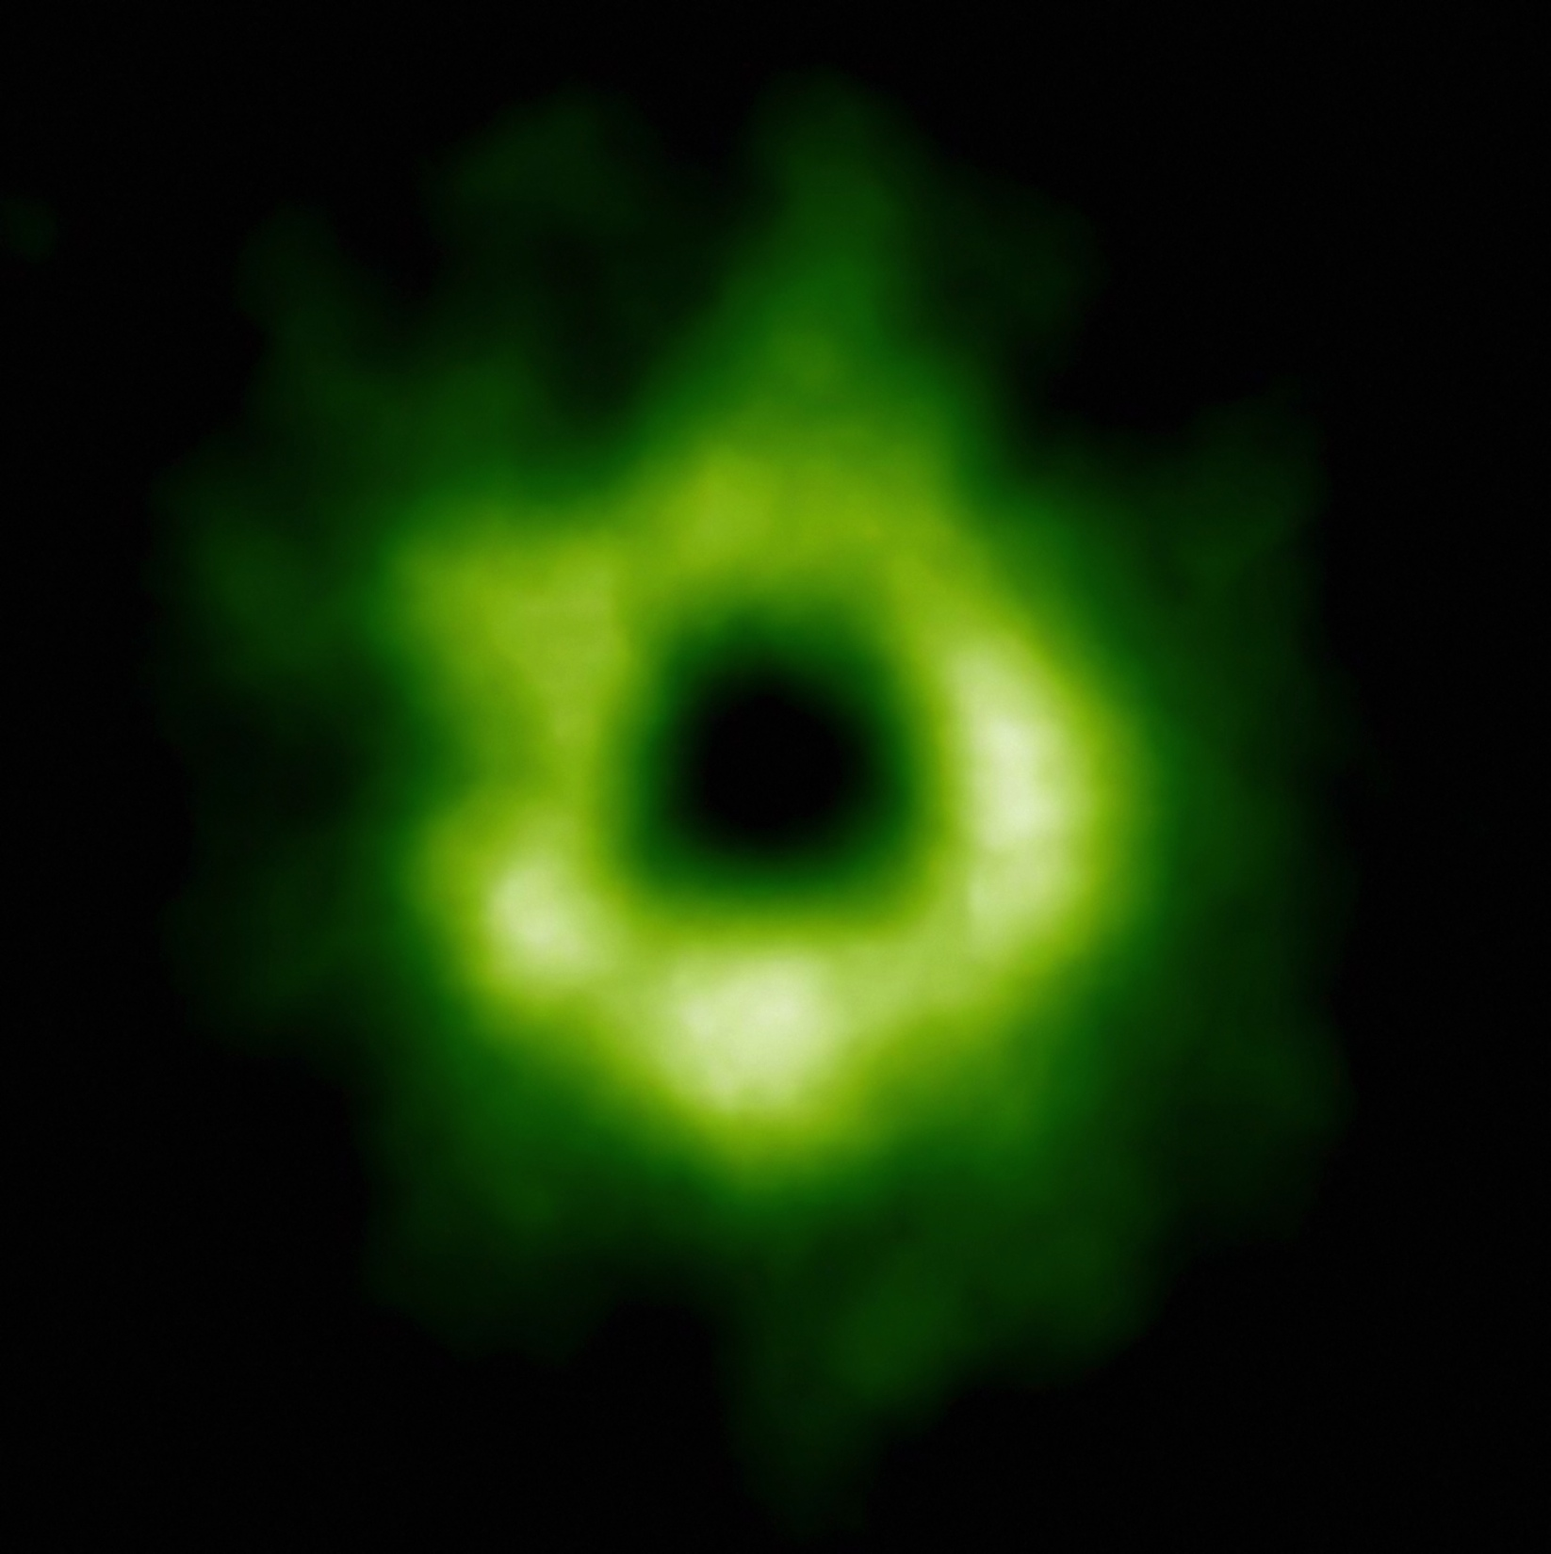
Snowline Locations in Protoplanetary Disks and C/N/O ratios
Notes:
Put the green TWHya figure instead.

Slide 37
BASIC IDEA
Understand the disk well enough to:
Predict what kind of planet compositions result from planet formation in different parts of the disk
Back-track the planet formation location based on the planet composition

Slide 38
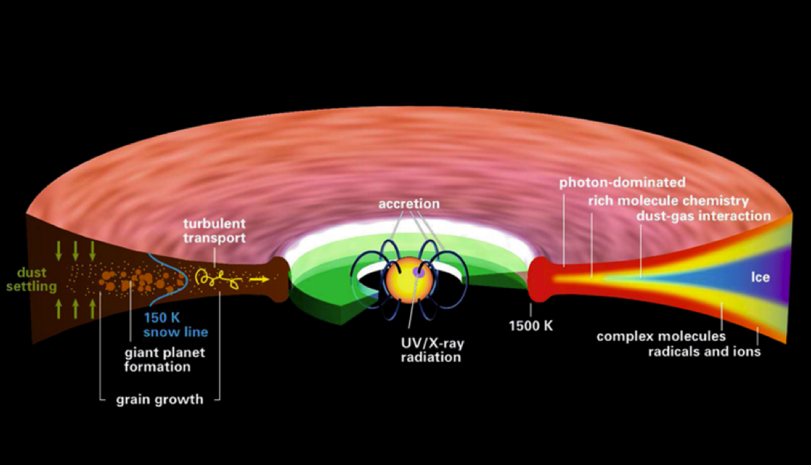
Disk structure is complex!
Henning&Semenov (2013)
Notes:
Remove the while and make the figure bigger.

Slide 39
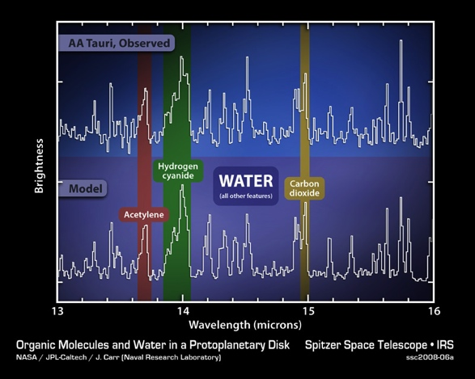
Volatile compounds have been detected in protoplanetary disks
Oberg+11
Notes:
Replace with spitzer water in disks spectrum image and DCO+ image.

Slide 40
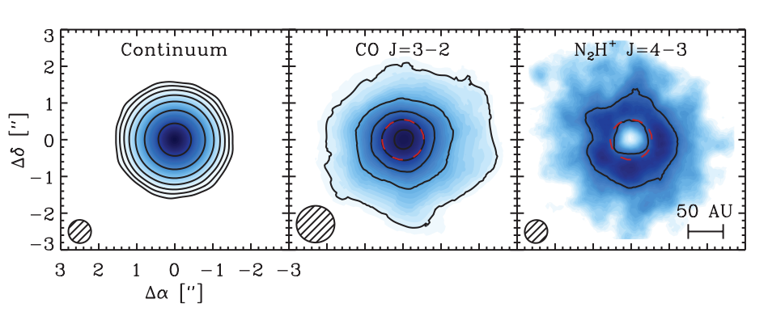
Snowlines of volatile molecules have been detected in disks
Qi+13

Slide 41
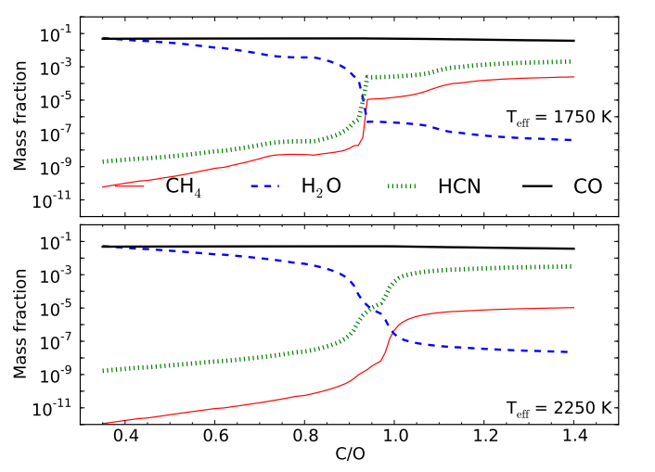
C/O ratio is an important signature of atmospheric chemistry
Molliere+15

Slide 42
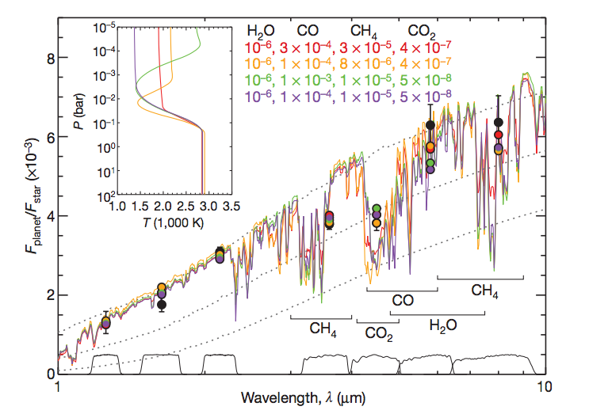
Some giant planets may have C/O ratios different from the stellar value of 0.54
Madhusudhan+11
Notes:
Show a slide before this with model predictions. Arxiv paper by katherine lodders.2009 figure 1.8

Slide 43
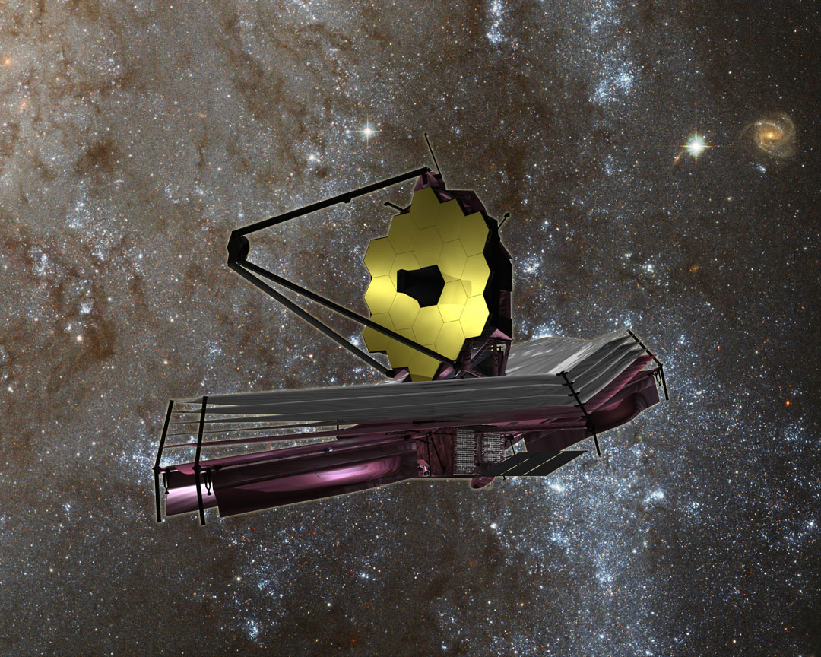

Slide 44
WHY Different C/O Ratios?
Possible explanation: main carriers of C and O, i.e. H₂O, CO₂ and CO, have different condensation temperatures => variations in the abundances of C and O in solids and gas between the snow lines of these volatiles

Slide 45
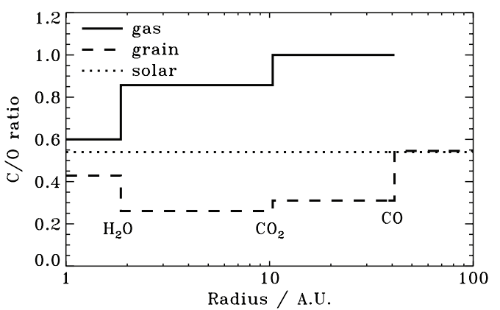
Oberg+11
After Oberg+11

Slide 46
Understand how radial drift, gas accretion and ice morphology affect snowline locations, and thus the C/O ratio in gas and dust throughout the disk
GOAL

Slide 47
Radial drift of solids
Gas moves at sub-Keplerian velocity:
v_{gas} ~ v_{K} (1-c_{s}² / v_{k}²)
Small particles (~micron size) move with the gas
Large particles (~km size) are unaffected by gas drag
“Intermediate sized” particles (~cm-m size) experience a headwind and drift towards the star

Slide 48
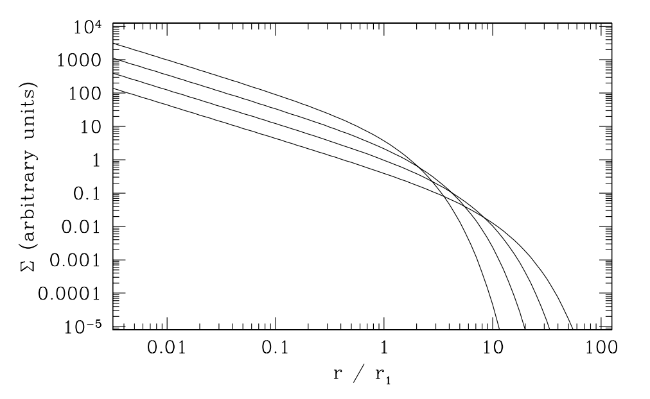
Gas disk accretes onto the central star
alpha-disk prescription: ν = α c_{s} H
Armitage 2009

Slide 49
Timescales for desorption, radial drift and gas accretion ARE comparable
Piso, Oberg, Birnstiel, Murray-Clay (2015)

Slide 50
We determined upper limits for the C/O ratio across the disk
Piso, Oberg, Birnstiel, Murray-Clay (2015)

Slide 51
Ice Morphology
The binding energies of CO varies by a factor of ~1.7 depending on whether CO is pure or water dominated ice
Credit: Edith Fayolle

Slide 52
Disk dynamics and ice morphology may change the CO snowline location by a factor of 7!
Piso, Oberg, Pegues (2016, in prep)
Notes:
Split in 2 slides; talk about N/O, then next slide say the same holds true for C/O

Slide 53
Disk dynamics and ice morphology may change the CO snowline location by a factor of 7!
H₂O
CO₂
CO
Piso, Oberg, Pegues (2016, in prep)
Notes:
Split in 2 slides; talk about N/O, then next slide say the same holds true for C/O

Slide 54
Disk dynamics and ice morphology may change the CO snowline location by a factor of 7!
H₂O
CO₂
CO
Disk dynamics
=> factor of ~2
Piso, Oberg, Pegues (2016, in prep)
Notes:
Split in 2 slides; talk about N/O, then next slide say the same holds true for C/O

Slide 55
Disk dynamics and ice morphology may change the CO snowline location by a factor of 7!
H₂O
CO₂
CO
Disk dynamics
=> factor of ~2
Ice morphology
=> factor of ~3-4
Piso, Oberg, Pegues (2016, in prep)
Notes:
Split in 2 slides; talk about N/O, then next slide say the same holds true for C/O

Slide 56
Disk dynamics and ice morphology may change the CO snowline location by a factor of 7!
H₂O
CO₂
CO
Disk dynamics
=> factor of ~2
Ice morphology
=> factor of ~3-4
CO snowlines span 10-70 AU!
Piso, Oberg, Pegues (2016, in prep)
Notes:
Split in 2 slides; talk about N/O, then next slide say the same holds true for C/O

Slide 57
More volatile snowlines in disks
Piso, Pegues, Oberg (2016)

Slide 58
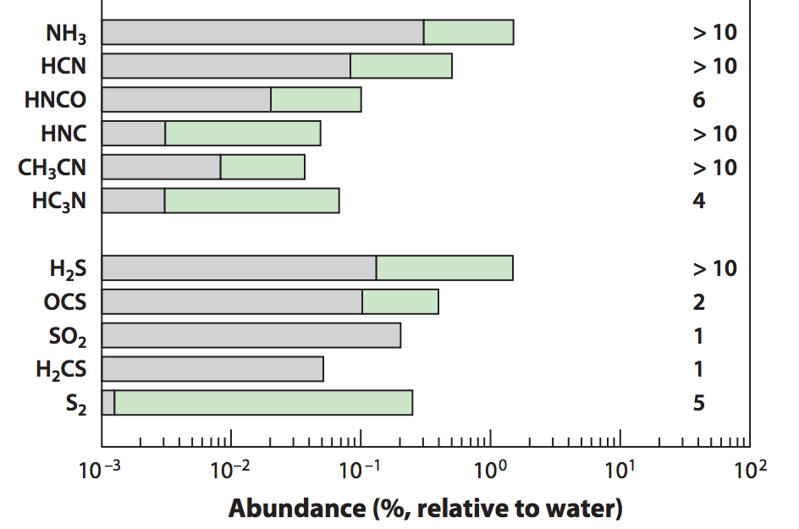
Nitrogen is important!
Add nitrogen-bearing molecules – nitrogen highly abundant in the Solar System and in disks and primarily found as N₂
Some N present in the form of NH₃
=> Use the median and maximum NH₃ abundances observed in protostellar cores from Spitzer c2d Legacy ice survey (Oberg et al. 2008, Oberg et al. 2011, etc.)
Mumma&Charnley(2011)
Notes:
Separate in two slides
Mention NH3 most abundant nitrogen carrier, bot low percentage of total N abundance => the rest in N2
Ice spectra or table
Show desorption curves from Edith’s paper

Slide 59
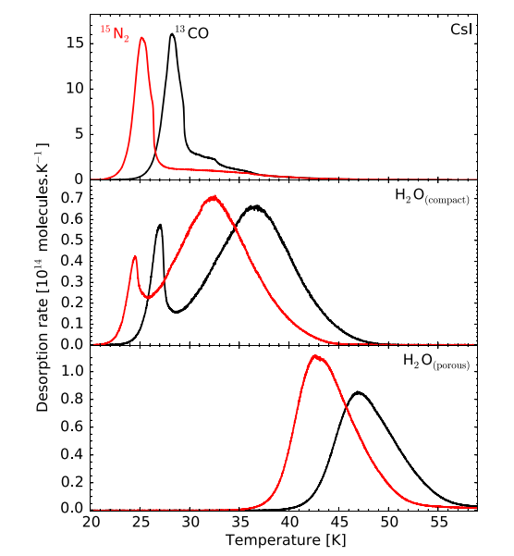
Ice Morphology
The binding energies of N₂ varies by a factor of ~1.7 depending on whether N2 is pure or water dominated ice
Fayolle+16

Slide 60
N/O ratios in static disks: highly enhanced gas N/O compared to the average value
Piso, Pegues, Oberg (2016)
Notes:
1) Focus on NH3 abundance, even with max NH3 still have enhanced N/O; block out bottom 2 panels first to talk about N/O

Slide 61
Disk dynamics and ice morphology may change the N₂ snowline locations by a factor of 7!
Piso, Pegues, Oberg (2016)
Notes:
Split in 2 slides; talk about N/O, then next slide say the same holds true for C/O

Slide 62
Takeaway point 2: Gas phase N/O ratios are highly enhanced throughout most of the disk compared to the average value, and more enhanced than the C/O ratio
Takeaway point 3: The locations of the CO and N₂ snowlines are highly uncertain and can span several tens of AU due to disk dynamics and ice morphology => observations are KEY

Slide 63
NEXT STEPS
Henning&Semenov (2013)

Slide 64
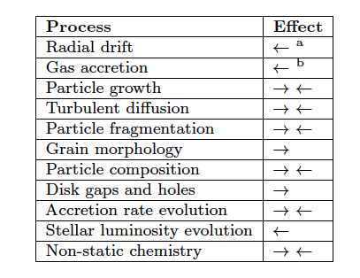
Additional chemical and dynamical processes to be explored
Piso, Oberg, Birnstiel, Murray-Clay (2015)
Piso+15

Slide 65
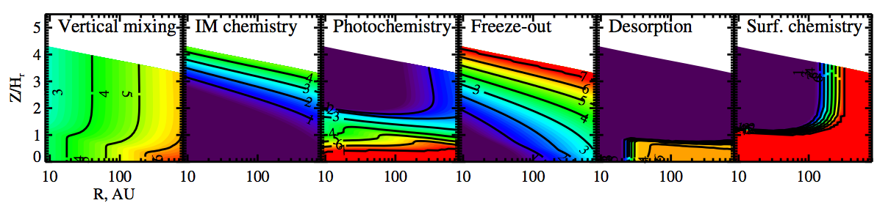
Chemistry and Dynamics need to be coupled
Semenov & Wiebe (2011)

Slide 66
Fundamental Questions
Where in the disk can giant planets form?
What compositions will the formed giant planets have obtained?
Notes:
----- Meeting Notes (4/22/16 11:46) -----
-add papers to last slide

Slide 68
Summary slide restating results both from core accretion and snowlines papers
Future directions: table from paper I and chemical timescale plot from Semenov & Wiebe 2011 plot

Slide 69
Private defense
Show EOS plots
Show final vs initial distance plots
Show fractional mass vs distance/time plots?
Discuss time-dependent C/N/O ratios; show plot for steady state disk if it exists; show equations on how to further expand model for evolving disk

Slide 70
Core accretion sketches and intro from previous talks
Summary of model assumptions
Have delad plots
Show result for polytropic EOS, then realistic EOS, then grain growth; either show plot for grain growth with coagulation or mention that coagulation will significantly decrease Mcrit
Takeaway point: Mcrit is highly dependent on disk location and properties, and may be as low as 1 ME; have Hr 8799 plot again

Slide 71
The Role of Disk Dynamics and Ice Morphology for Snowlines and the C/N/O Ratios
Restate that disk compositions regulat planet compositions; show image of planet accreting disk material
Introductory slides with disk processes, volatile detections in disk, CO snowline, WASP 12 b C/O “detection” and show show a picture of JWST; put disk cartoon later, C/O theoretical model
Introduce the idea of Oberg+11 and show plot
We expand this model by… introductory drift slide and gas accretion slide
Show timescales plot?
Show C/O plot from Paper I
Lead with ice morphology for CO; show Edith’s plot, then C/O plot; at the end mentuon that CH4 doesn’t really matter; then go to nitrogen
But, other volatile to consider besides H2O, CO2, CO if we want to better constrain disk/planet compositions; i.e. nitrogen carriers; at the end mentuon that CH4 doesn’t really matter
Show top part of snowlines plot
Explain that nitrogen is abundant in the solar system and why it is primarily N2 (show e.g. comet abundance plot and Karin’s 2011 paper); N2 highly volatile hence N/O ratio may be more enhanced than C/O; moreover, there’s also some NH3
Snow N/O static disk plot and mention high enhancement
Snowlines are also highly dependent on ice morphology; show plot from Edith’s paper
Show N/O ratio plot (in stages) to demonstrate how disk dynamics and ice morphology affect snowline locations
Takeaway point 1: N/O ratio enhanced throughout most of the disk, more enhanced than C/O; thus could be used to a trace a planet’s formation origin
Takeaway point 2: CO and N2 snowline locations highly uncertain and can span several tens of AU due to disk dynamics and ice morphology; need observations

